Slide 1

Evolutions in Ship Operations
Digital Skills 1
Lesson 3

Slide 2
Suggested Method of Study
Read through the presentation material, referring to the links included, then watch the video clips.
Once you have gone through all the material, answer the questions in the VLE quiz.
After the lesson, you may wish to investigate the topic further, based on the discussion points and suggested further reading.
Use the material provided for this lesson as part of your revision for the final assessment.

Slide 3
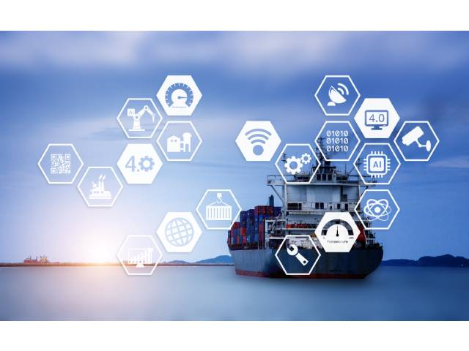
Lesson Content
Economic Drivers
Safety Related Drivers
Key Technological Developments
Video Clips
Quiz
Further Reading (optional)
Topics for Further Discussion (optional)

Slide 4
1. Economic Drivers
(for ship owners to become more efficient)

Slide 5

Price x Sales - Variable costs - Fixed costs = Profit
Variable costs decrease if production increases
Fixed costs decrease if labour costs decrease
Capital increase AND/OR Labour input increase AND Technological advancement
= Long Term Growth
Technological advancement allows/encourages redistribution of costs
  e.g. if electric kettles boils water quickly, we don’t need to spend time building a fire every time someone needs to boil water, but we do need a reliable source of electricity.

Slide 6
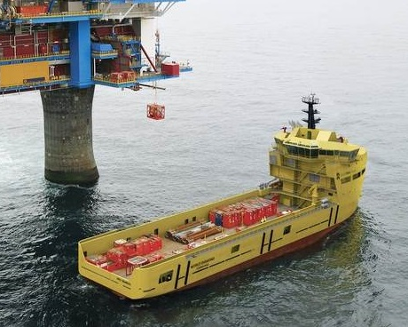

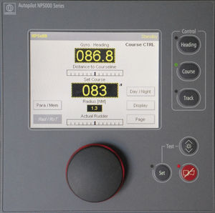
Automated systems on a vessel allow duties and responsibilities to be adjusted and reallocated. They are currently used to support the crew during operations.
E.g. UMS
E.g.2. Auto-pilot
E.g.3. Dynamic Positioning
If implemented effectively, they should increase onboard efficiency and safety.

Slide 7
2. Safety Related Drivers
(and examples of technological changes focusing on human factors)

Slide 8
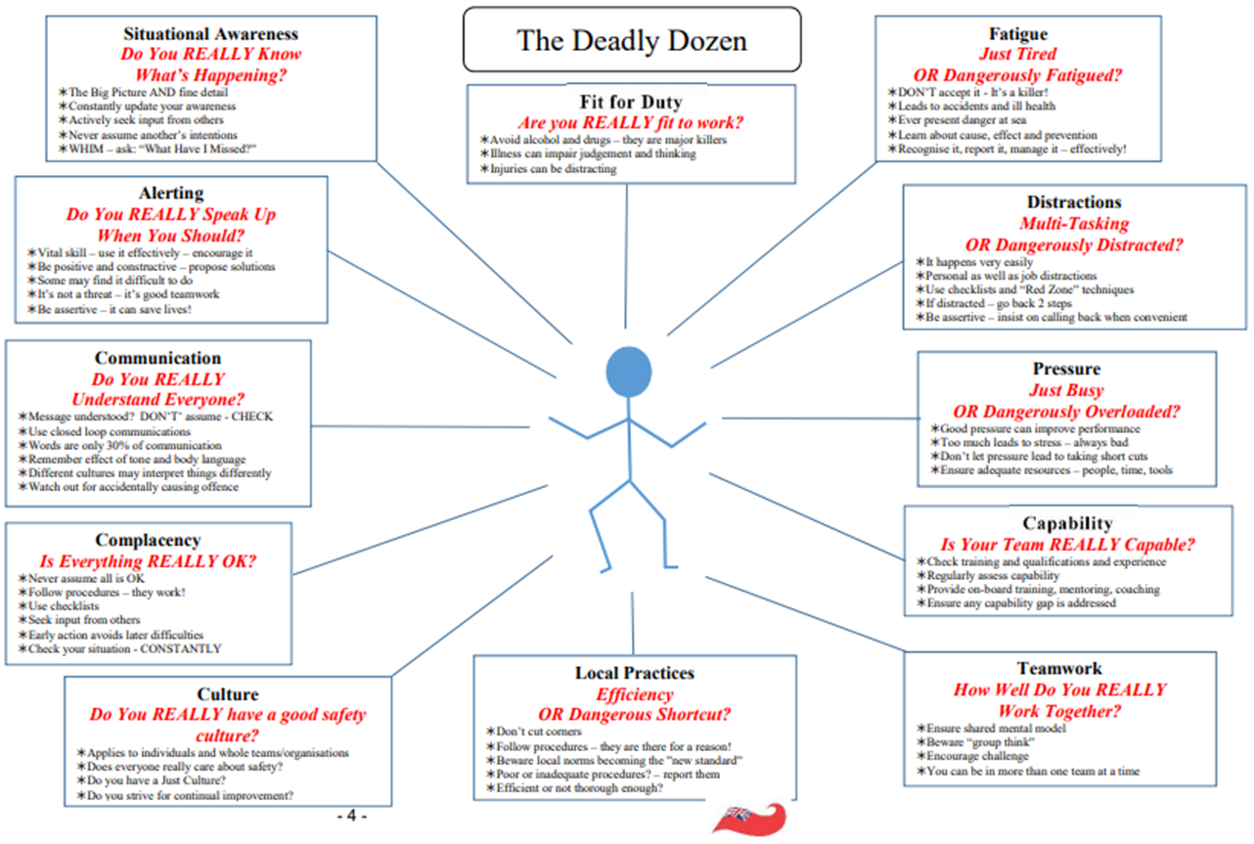
https://assets.publishing.service.gov.uk/government/uploads/system/uploads/attachment_data/file/837844/MGN_520_Final.pdf

Slide 9
Top 12 Human Factors: Safety | Example of Technological Change | Operational Example
Fit for Duty | Communication links between work and home | Internet
Situational Awareness | Improving data accessibility and accuracy | Rudder indicator
Alerting | Efficient ship to shore communication systems | Inmarsat C
Communication | End user interface options | Stability calculators
Complacency | Expanding range of monitoring equipment | Level gauging in tanks
Culture | Access to onboard training and support | VLEs
Local Practices | Globalisation | STCW
Teamwork | Online forums linking a global community | Zoom/Teams
Capability | Virtual environments used in training programmes | Simulators
Pressure | Automation as part of standard operations | UMS
Distractions | Controllable limitations on data access | ECDIS (SCAMIN)
Fatigue | Application of experimental research | Project MARTHA (Solent)
https://www.solent.ac.uk/research-innovation-enterprise/documents/martha-final-report.pdf

Slide 10
3. Key Technological Developments
(and their impact on ship operations)

Slide 11
Autonomous or automated shipping and equipment
“Smart shipping”
Energy efficiency and management
Monitoring performance and operations
Paperless systems and cybersecurity
Increasing ship sizes (e.g. container vessels)
https://www.imarest.org/policy-news/thought-leadership/1010-technology-in-shipping/file
https://unctad.org/system/files/official-document/rmt2020_en.pdf
https://unctad.org/news/bigger-ships-and-fewer-companies-two-sides-same-coin

Slide 12
Technological Development | Example of Impact on Ship Operations
Automated shipping and equipment | Automated processes are already in place. As more operations become automated, crew roles will shift towards monitoring and maintenance of operating systems
“Smart shipping” | High levels of hard data (e.g. sensory or physical) used in decision making. Less reliance on instincts or gut reactions. More shore based control due to large range of data inputs.
Energy efficiency and management | New fuel and ship construction technologies require new skillset and systems onboard. Strong links with ”Smart Shipping”. (See Green Skills 1 for more information).
Monitoring performance and operations | Required to develop alongside the other developments as the crew and shore team adjust their focus to supervising operations rather than directly participating.
Paperless systems and cybersecurity | Balancing the need to update regulations and procedures regularly with the need for effective implementation. Technology improvements lead to new threats, requiring new improvements which creates complexities in onboard operations and training.
Ships increasing in size | Increased reliance on logistic and cargo management technologies, with crew and port operators using them to plan, agree and monitor operations.
NB: References on next slide

Slide 13
Technological Development | Example of Impact on Ship Operations
Automated shipping and equipment | https://www.oecd.org/future-of-work/reports-and-data/what-happened-to-jobs-at-high-risk-of-automation-2021.pdf
“Smart shipping” | https://www.maersk.com/digital-solutions
Energy efficiency and management | See Green Skills 1 SkillSea Course
Monitoring performance and operations | http://www.ppmc-transport.org/on-board-monitoring-showing-real-world-emissions/ https://www.abs-group.com/What-We-Do/Software-Solutions/Nautical-Systems-Software/Voyage-Manager/
Paperless systems and cybersecurity | https://www.ics-shipping.org/wp-content/uploads/2020/08/guidelines-on-cyber-security-onboard-ships-min.pdf
Ships increasing in size | https://www.itf-oecd.org/sites/default/files/docs/15cspa_mega-ships.pdf
https://assets.publishing.service.gov.uk/government/uploads/system/uploads/attachment_data/file/872194/Maritime_2050_Report.pdf
https://www.oecd.org/economy/growth/scenarios-for-the-world-economy-to-2060.htm#main_findings

Slide 14
4. Video Clips

Slide 15
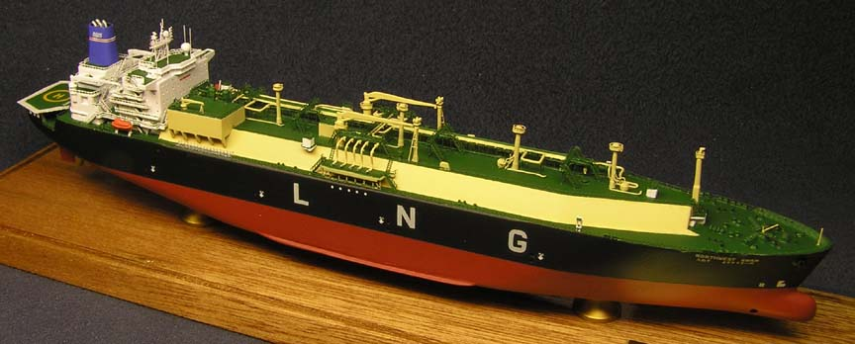
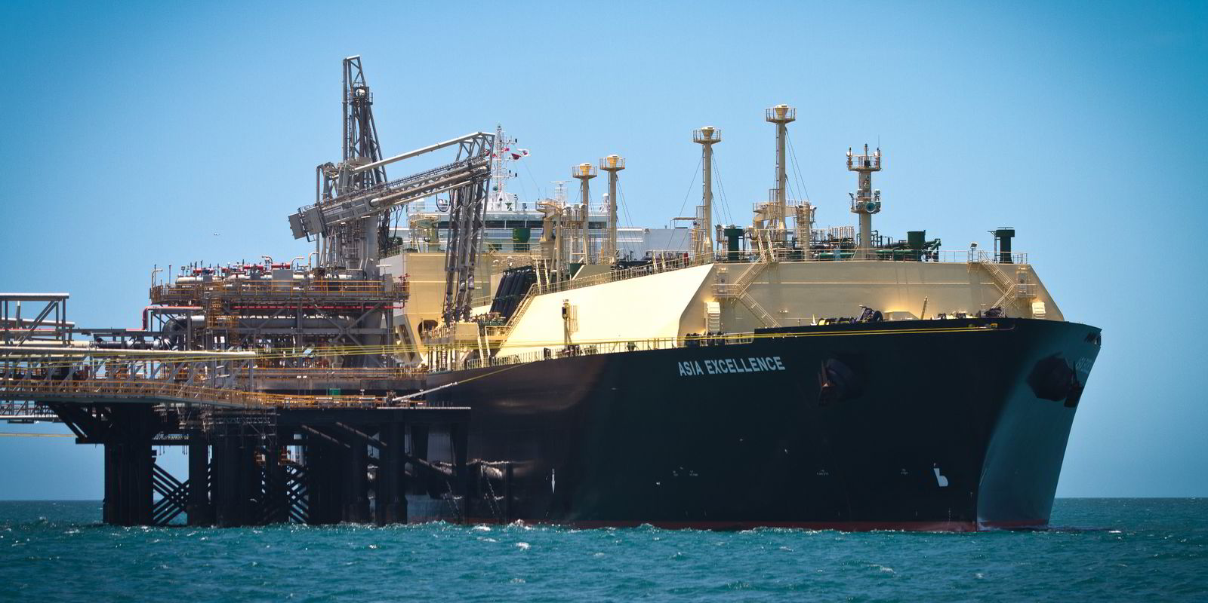
Video clip: Asia Excellence and Northwest Swan https://www.chevron.com/operations/transportation/shipping (3’)

Slide 16
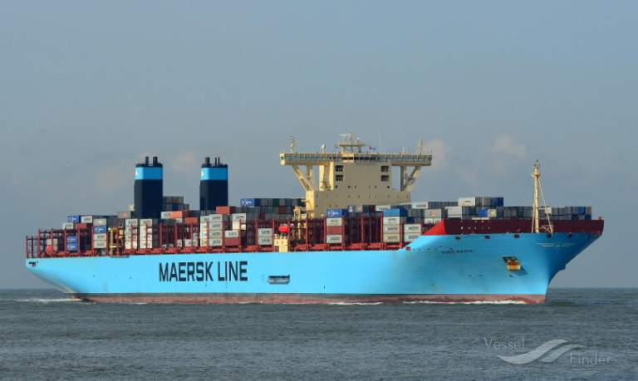
Video clip: Marie Maersk engine room https://www.youtube.com/watch?v=Jfqgbf2AvpM (3’)

Slide 17
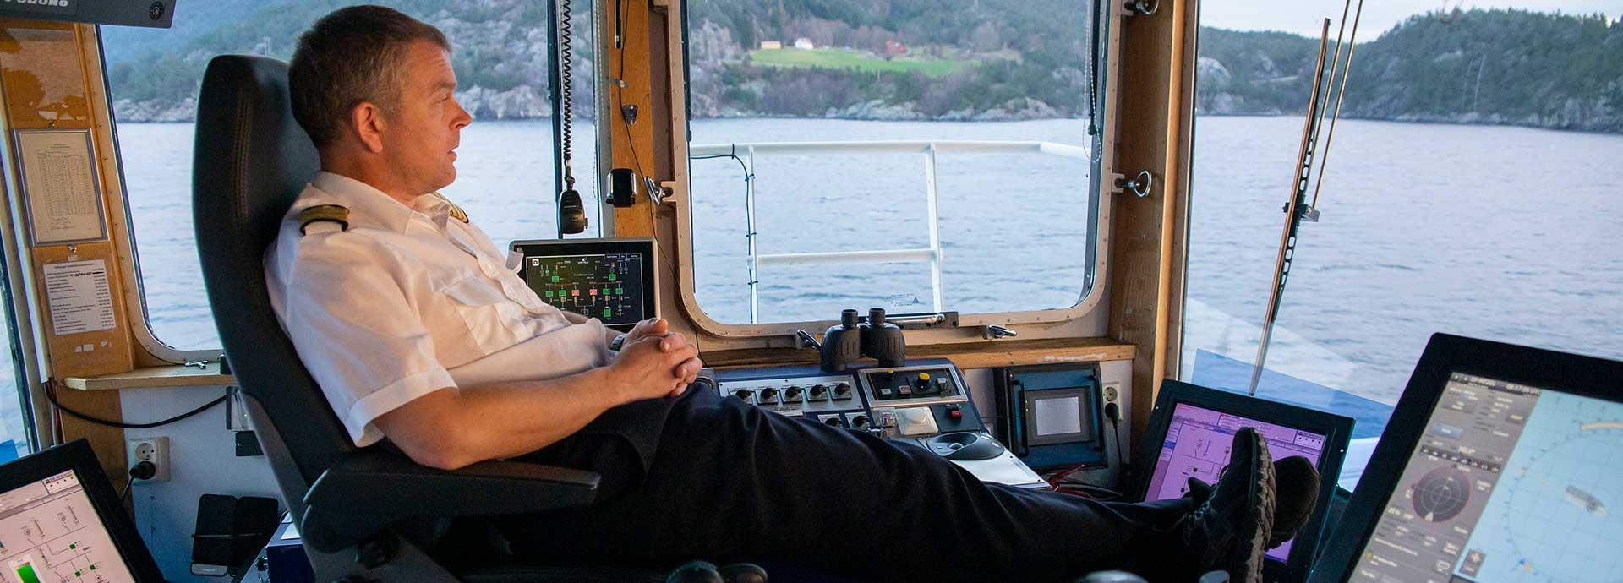
Video clips:
Wartsila defining automated and autonomous shipping https://www.wartsila.com/insights/article/maritime-autonomy-a-bridge-too-far (2’) https://www.youtube.com/watch?v=LCElbM4bCb0 (Optional: 15’)

Slide 18
5. Quiz
Please use the link below this presentation to access the quiz

Slide 19
6. Further Reading
https://northsearegion.eu/northsee/s-hipping/drivers-and-enablers-for-future-shipping-activities/
https://www.shmgroup.com/blog/evolution-technology-shipping/
https://www.lr.org/en/insights/global-marine-trends-2030/global-marine-technology-trends-2030/
https://www.trelleborg.com/marine-and-infrastructure/-/media/Marine-Systems/Resources/Whitepapers-and-Barometer-Reports/Downloads/TMS_SmartPort_InsightBee_Report.pdf?rev=30d0a67e180a42b6be418d66362dce3e
https://www.inmarsat.com/content/dam/inmarsat/corporate/documents/maritime/insights/Inmarsat_ICT_Best_Practice_Guide_2019.pdf
https://significance.nl/wp-content/uploads/2019/03/2016-BZO-Evolution-of-the-EU-and-international-shipping-drivers-challenges-and-scenarios.pdf
https://ec.europa.eu/transport/sites/transport/files/modes/maritime/studies/doc/2015-june-study-sss-final.pdf
https://unctad.org/system/files/official-document/rmt2018_en.pdf (Chapter 5)

Slide 20
7. Topics for Further Discussion
Will the evolution of ship operations eliminate the role of humans on ships?
Has technology made shipping safer and/or more efficient?

